Slide 1
28
Unemployment and Its Natural Rate

Slide 2
IDENTIFYING UNEMPLOYMENT
Categories of Unemployment
  The problem of unemployment is usually divided into two categories.
  The long-run problem and the short-run problem:
    The natural rate of unemployment
    The cyclical rate of unemployment

Slide 3
IDENTIFYING UNEMPLOYMENT
Natural Rate of Unemployment
  The natural rate of unemployment is unemployment that does not go away on its own even in the long run.
  It is the amount of unemployment that the economy normally experiences.

Slide 4
IDENTIFYING UNEMPLOYMENT
Cyclical Unemployment
  Cyclical unemployment refers to the year-to-year fluctuations in unemployment around its natural rate.
  It is associated with with short-term ups and downs of the business cycle.

Slide 5
IDENTIFYING UNEMPLOYMENT
Describing Unemployment
  Three Basic Questions:
    How does government measure the economy’s rate of unemployment?
    What problems arise in interpreting the unemployment data?
    How long are the unemployed typically without work?

Slide 6
How Is Unemployment Measured?
Unemployment is measured by the Bureau of Labor Statistics (BLS).
  It surveys 60,000 randomly selected households every month.
  The survey is called the Current Population Survey.

Slide 7
How Is Unemployment Measured?
Based on the answers to the survey questions, the BLS places each adult into one of three categories:
  Employed
  Unemployed
  Not in the labor force

Slide 8
How Is Unemployment Measured?
The BLS considers a person an adult if he or she is over 16 years old.

Slide 9
How Is Unemployment Measured?
A person is considered employed if he or she has spent most of the previous week working at a paid job.

Slide 10
How Is Unemployment Measured?
A person is unemployed if he or she is on temporary layoff, is looking for a job, or is waiting for the start date of a new job.

Slide 11
How Is Unemployment Measured?
A person who fits neither of these categories, such as a full-time student, homemaker, or retiree, is not in the labor force.

Slide 12
How Is Unemployment Measured?
Labor Force
  The labor force is the total number of workers, including both the employed and the unemployed.
  The BLS defines the labor force as the sum of the employed and the unemployed.

Slide 13

Figure 1 The Breakdown of the Population in 2001
Employed
Labor Force
(135.1 million)
(141.8 million)
Adult
Population
(211.9 million)
Unemployed (6.7 million)
Not in labor force
(70.1 million)
Copyright©2003 Southwestern/Thomson Learning

Slide 14
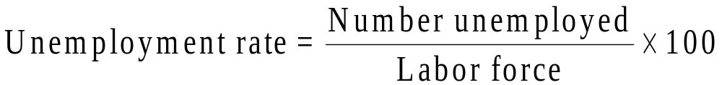
How Is Unemployment Measured?
The unemployment rate is calculated as the percentage of the labor force that is unemployed.

Slide 15
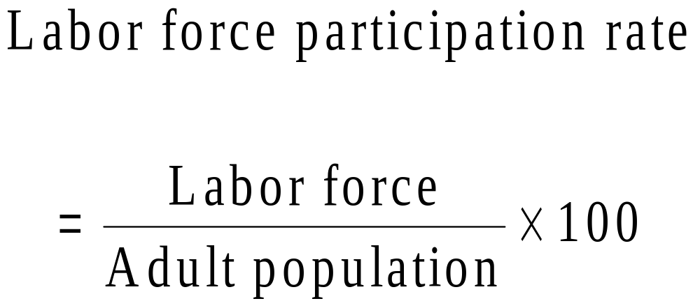
How Is Unemployment Measured?
The labor-force participation rate is the percentage of the adult population that is in the labor force.

Slide 16

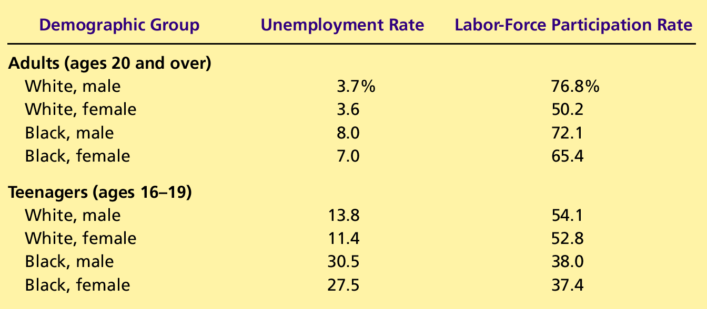
Table 1 The Labor-Market Experiences of Various Demographic Groups
Copyright©2004 South-Western

Slide 17
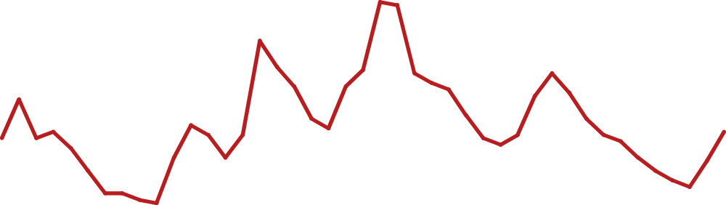
Figure 2 Unemployment Rate Since 1960
Percent of
Labor Force
10
Unemployment rate
8
6
4
Natural rate of
unemployment
2
0
1960
1965
1970
1975
1980
1985
1990
1995
2000
2005
Copyright©2003 Southwestern/Thomson Learning

Slide 18

Figure 3 Labor Force Participation Rates for Men and Women Since 1950
Labor-Force
Participation
Rate (in percent)
100
Men
80
60
40
Women
20
0
1950
1955
1960
1965
1970
1975
1980
1985
1990
1995
2000
Copyright©2003 Southwestern/Thomson Learning

Slide 19
Does the Unemployment Rate Measure What We Want It To?
It is difficult to distinguish between a person who is unemployed and a person who is not in the labor force.
Discouraged workers, people who would like to work but have given up looking for jobs after an unsuccessful search, don’t show up in unemployment statistics.
Other people may claim to be unemployed in order to receive financial assistance, even though they aren’t looking for work.

Slide 20
How Long Are the Unemployed without Work?
Most spells of unemployment are short.
Most unemployment observed at any given time is long-term.
Most of the economy’s unemployment problem is attributable to relatively few workers who are jobless for long periods of time.

Slide 21
Why Are There Always Some People Unemployed?
In an ideal labor market, wages would adjust to balance the supply and demand for labor, ensuring that all workers would be fully employed.

Slide 22
Why Are There Always Some People Unemployed?
Frictional unemployment refers to the unemployment that results from the time that it takes to match workers with jobs. In other words, it takes time for workers to search for the jobs that are best suit their tastes and skills.

Slide 23
Why Are There Always Some People Unemployed?
Structural unemployment is the unemployment that results because the number of jobs available in some labor markets is insufficient to provide a job for everyone who wants one.

Slide 24
JOB SEARCH
Job search
  the process by which workers find appropriate jobs given their tastes and skills.
  results from the fact that it takes time for qualified individuals to be matched with appropriate jobs.

Slide 25
JOB SEARCH
This unemployment is different from the other types of unemployment.
  It is not caused by a wage rate higher than equilibrium.
  It is caused by the time spent searching for the “right” job.

Slide 26
Why Some Frictional Unemployment is Inevitable
Search unemployment is inevitable because the economy is always changing.
Changes in the composition of demand among industries or regions are called sectoral shifts.
It takes time for workers to search for and find jobs in new sectors.

Slide 27
Public Policy and Job Search
Government programs can affect the time it takes unemployed workers to find new jobs.
These programs include the following:
  Government-run employment agencies
  Public training programs
  Unemployment insurance

Slide 28
Public Policy and Job Search
Government-run employment agencies give out information about job vacancies in order to match workers and jobs more quickly.

Slide 29
Public Policy and Job Search
Public training programs aim to ease the transition of workers from declining to growing industries and to help disadvantaged groups escape poverty.

Slide 30
Public Policy and Job Search
Unemployment insurance is a government program that partially protects workers’ incomes when they become unemployed.
  Offers workers partial protection against job losses.
  Offers partial payment of former wages for a limited time to those who are laid off.

Slide 31
Public Policy and Job Search
Unemployment insurance increases the amount of search unemployment.
It reduces the search efforts of the unemployed.
It may improve the chances of workers being matched with the right jobs.

Slide 32
Public Policy and Job Search
Structural unemployment occurs when the quantity of labor supplied exceeds the quantity demanded.
Structural unemployment is often thought to explain longer spells of unemployment.

Slide 33
Public Policy and Job Search
Why is there Structural Unemployment?
  Minimum-wage laws
  Unions
  Efficiency wages

Slide 34
MINIMUM-WAGE LAWS
When the minimum wage is set above the level that balances supply and demand, it creates unemployment.

Slide 35
Figure 4 Unemployment from a Wage Above the Equilibrium Level
Wage
Surplus of labor
=
Labor
Unemployment
supply
Minimum
wage
W_{E}
Labor
demand
0
L_{D}
L_{E}
L_{S}
Quantity of
Labor
Copyright©2003 Southwestern/Thomson Learning

Slide 36
UNIONS AND COLLECTIVE BARGAINING
A union is a worker association that bargains with employers over wages and working conditions.
In the 1940s and 1950s, when unions were at their peak, about a third of the U.S. labor force was unionized.
A union is a type of cartel attempting to exert its market power.

Slide 37
UNIONS AND COLLECTIVE BARGAINING
The process by which unions and firms agree on the terms of employment is called collective bargaining.

Slide 38
UNIONS AND COLLECTIVE BARGAINING
A strike will be organized if the union and the firm cannot reach an agreement.
A strike refers to when the union organizes a withdrawal of labor from the firm.

Slide 39
UNIONS AND COLLECTIVE BARGAINING
A strike makes some workers better off and other workers worse off.
Workers in unions (insiders) reap the benefits of collective bargaining, while workers not in the union (outsiders) bear some of the costs.

Slide 40
UNIONS AND COLLECTIVE BARGAINING
By acting as a cartel with ability to strike or otherwise impose high costs on employers, unions usually achieve above-equilibrium wages for their members.
Union workers earn 10 to 20 percent more than nonunion workers.

Slide 41
Are Unions Good or Bad for the Economy?
Critics argue that unions cause the allocation of labor to be inefficient and inequitable.
  Wages above the competitive level reduce the quantity of labor demanded and cause unemployment.
  Some workers benefit at the expense of other workers.

Slide 42
Are Unions Good or Bad for the Economy?
Advocates of unions contend that unions are a necessary antidote to the market power of firms that hire workers.
They claim that unions are important for helping firms respond efficiently to workers’ concerns.

Slide 43
THE THEORY OF EFFICIENCY WAGES
Efficiency wages are above-equilibrium wages paid by firms in order to increase worker productivity.
The theory of efficiency wages states that firms operate more efficiently if wages are above the equilibrium level.

Slide 44
THE THEORY OF EFFICIENCY WAGES
A firm may prefer higher than equilibrium wages for the following reasons:
  Worker Health: Better paid workers eat a better diet and thus are more productive.
  Worker Turnover: A higher paid worker is less likely to look for another job.

Slide 45
THE THEORY OF EFFICIENCY WAGES
A firm may prefer higher than equilibrium wages for the following reasons:
  Worker Effort: Higher wages motivate workers to put forward their best effort.
  Worker Quality: Higher wages attract a better pool of workers to apply for jobs.

Slide 46
Summary
The unemployment rate is the percentage of those who would like to work but don’t have jobs.
The Bureau of Labor Statistics calculates this statistic monthly.
The unemployment rate is an imperfect measure of joblessness.

Slide 47
Summary
In the U.S. economy, most people who become unemployed find work within a short period of time.
Most unemployment observed at any given time is attributable to a few people who are unemployed for long periods of time.

Slide 48
Summary
One reason for unemployment is the time it takes for workers to search for jobs that best suit their tastes and skills.
A second reason why our economy always has some unemployment is minimum-wage laws.
Minimum-wage laws raise the quantity of labor supplied and reduce the quantity demanded.

Slide 49
Summary
A third reason for unemployment is the market power of unions.
A fourth reason for unemployment is suggested by the theory of efficiency wages.
High wages can improve worker health, lower worker turnover, increase worker effort, and raise worker quality.

